Slide 1

Application Layer Protocols
and
Services -5
Delivered By:
Avinash Bhagat
9463281930
avinash.bhagat@lpu.co.in
Copyright © The McGraw-Hill Companies, Inc. Permission required for reproduction or display.

Slide 2
Domain Name System (DNS) Chapter 25
TELNET Chapter 26
Simple Mail Transfer Protocol and Post Office Protocol Chapter 26
File Transfer Protocol Chapter 26
World Wide Web www Chapter27
Hyper text transfer Protocol HTTP Chapter27
Virtual Private Network (VPN) Chapter32
Firewalls Chapter32
Terminologies in Network Security Chapter30

Slide 3
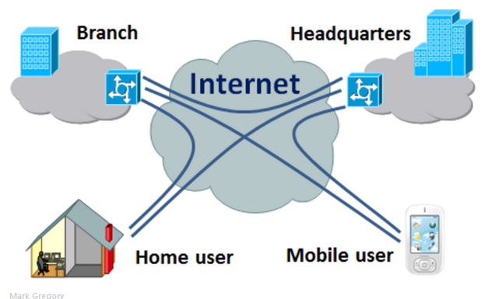
Virtual Private Networks (VPN)
Virtual
Private
Network

Slide 4
Virtual Private Networks (VPN)
To achieve privacy, organizations can use one of three strategies:
Private networks,
Hybrid networks,
Virtual private networks

Slide 5
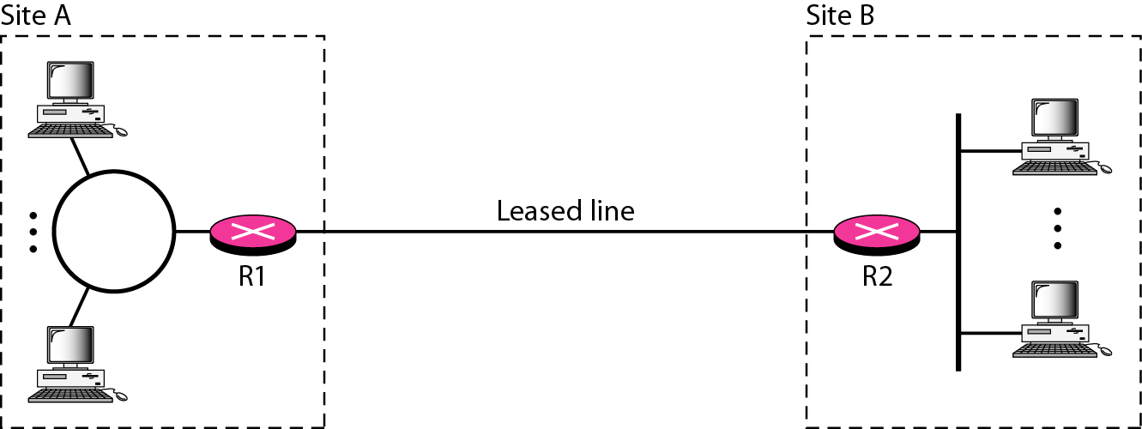
Private Networks
A larger organization with several sites can create a private internet. The LANs at different sites can be connected to each other by using routers and leased lines.

Slide 6
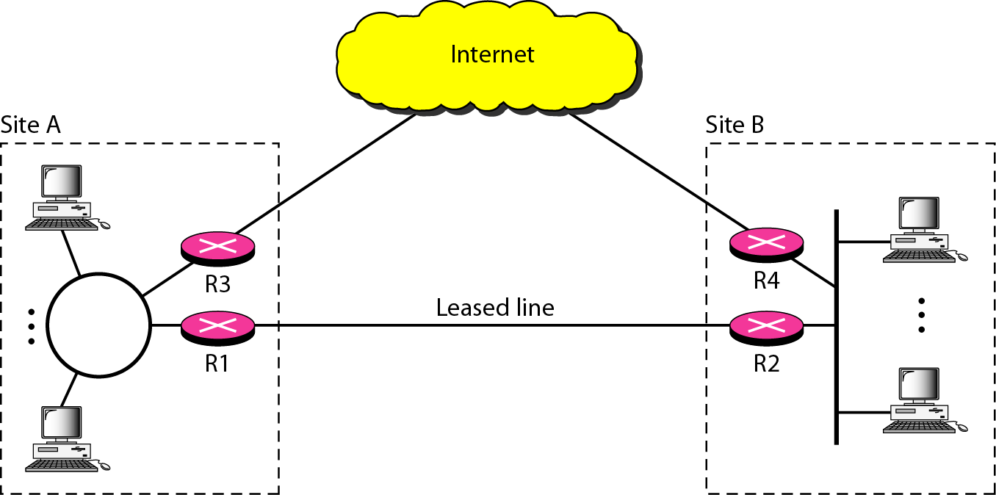
Hybrid Network
A hybrid network allows an organization to have its own private internet and, at the same time, access to the global Internet.

Slide 7
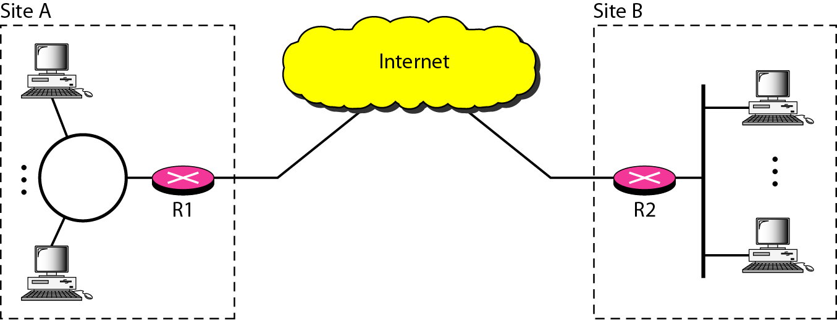
Virtual Private Networks (VPN)
Both private and hybrid networks have a major drawback: cost. Private wide-area networks (WANs) are expensive.
A technology called virtual private network allows organizations to use the global Internet for both purposes.

Slide 8
Virtual Private Networks (VPN)
VPN creates a network that is private but virtual.
It is private because it guarantees privacy inside the organization.
It is virtual because it does not use real private WANs; the network is physically public but virtually private.

Slide 9
Virtual Private Networks (VPN)
Virtual private network (VPN) is a technology that is implemented by large organizations that use the global Internet for both intra and inter-organization communication, but require privacy in their internal communications.

Slide 10
Virtual Private Networks (VPN)
A private network is designed for use inside an organization. It allows access to shared
resources and, at the same time, provides privacy.
Two commonly used, related terms:
Intranet
Extranet.

Slide 11
Virtual Private Networks (VPN)
Intranet An intranet is a private network (LAN) that uses the Internet model. However, access to the network is limited to the users inside the organization.
Usage
The network uses application programs defined for the global Internet, such as HTTP, and may have
Web servers, print servers, file servers, and so on.

Slide 12
Virtual Private Networks (VPN)
Extranet An extranet is the same as an intranet with one major difference:
Some resources may be accessed by specific groups of users outside the organization under the control of the network administrator.
Example,
an organization may allow authorized customers access to product specifications, availability, and online ordering.
A university can allow distance learning students access to the computer lab after passwords have been checked.

Slide 13
Virtual Private Networks (VPN)
Addressing in a private network (IP addresses)
Option1
The network can apply for a set of addresses from the Internet authorities and use them without being connected to the Internet.
Advantage. If in the future the organization decides to be connected to the Internet, it can do so with relative ease.
Disadvantage: The address space is wasted

Slide 14
Virtual Private Networks (VPN)
Option2
The network can use any set of addresses without registering with the Internet authorities.
Because the network is isolated, the addresses do not have to be unique.
Serious drawback Users might mistakenly confuse the
addresses as part of the global Internet.

Slide 15
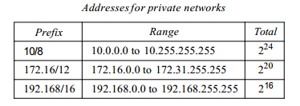
Virtual Private Networks (VPN)
Option3
To overcome the problems associated with the first and second strategies, the Internet
authorities have reserved three sets of addresses.

Slide 16
Virtual Private Networks (VPN)
Any organization can use an address out of this set without permission from the Internet authorities.
Everybody knows that these reserved addresses are for private networks. They are unique inside the organization, but they are not unique globally. No router will
forward a packet that has one of these addresses as the destination address.

Slide 17
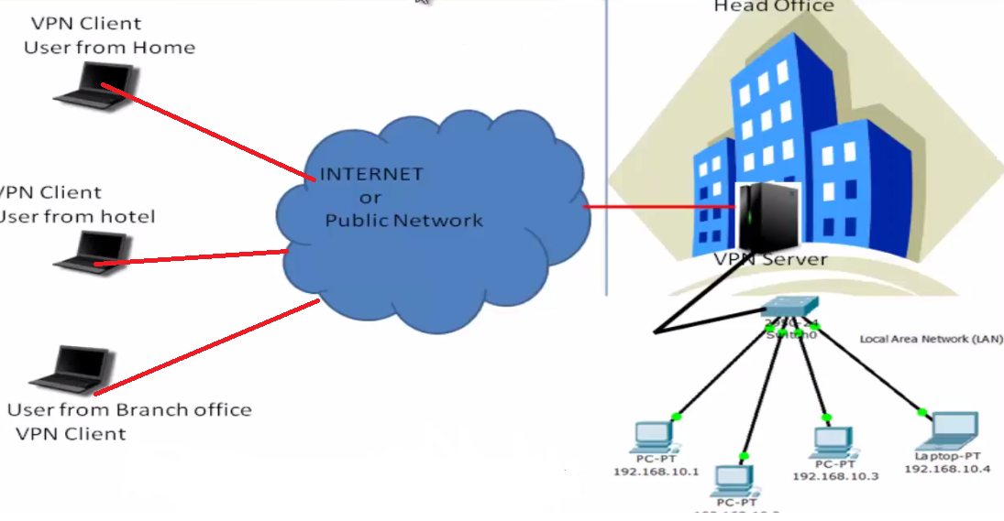
VPN Technology

Slide 18
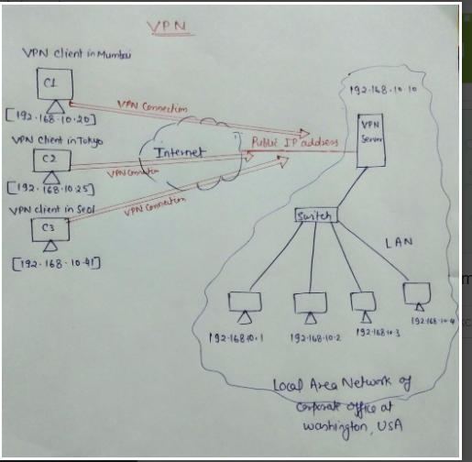
VPN Technology

Slide 19
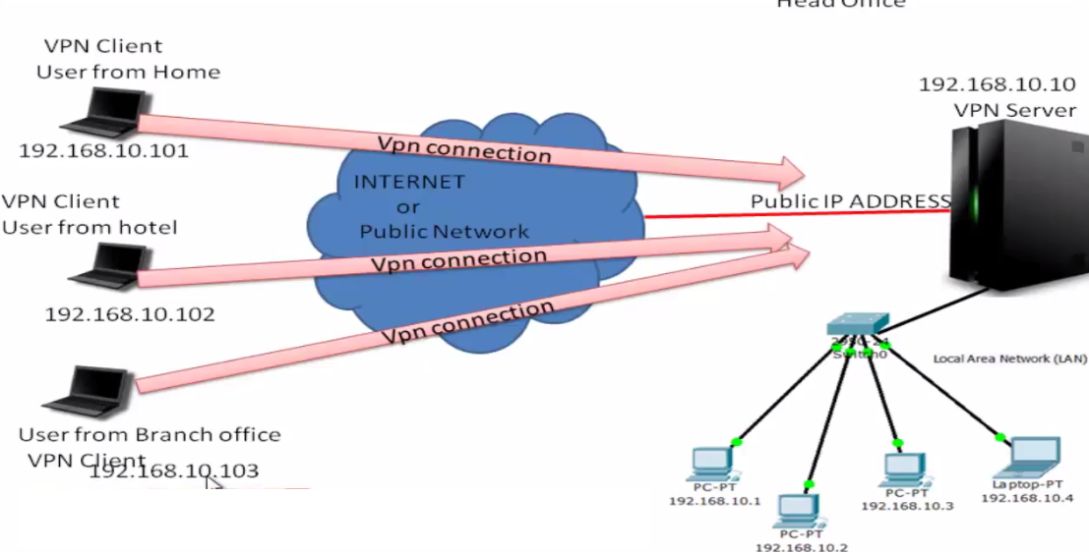
VPN Technology Concept of tunneling

Slide 20
Subjective Questions
Write a note on Virtual Private Network

Slide 21
Multiple Choice Questons
A _______network is used inside an organization.
a. private
b. public
c. semi-private
d. semi-public
10.172.45.53/8 is a __________________ network
a. private
b. public
c. semi-private
d. semi-public

Slide 22
Multiple Choice Questons
A _______network is used inside an organization.
a. private
b. public
c. semi-private
d. semi-public
10.172.45.53/8 is a __________________ network
a. private
b. public
c. semi-private
d. semi-public

Slide 23
Multiple Choice Questons
192.172.45.53/16 is a __________________ network
a. private
b. public
c. semi-private
d. semi-public
A ______ provides privacy for LANs that must communicate through the global Internet.
a. VPP
b. VNP
c. VNN
d. VPN

Slide 24
Multiple Choice Questons
192.172.45.53/16 is a __________________ network
a. private
b. public
c. semi-private
d. semi-public
A ______ provides privacy for LANs that must communicate through the global Internet.
a. VPP
b. VNP
c. VNN
d. VPN

